Slide 1

Songs Analysis in Power BI
Presented by:
Ikrama Dayyabu Hayatu

Slide 2

CONTENT
OVERVIEW
EXPLORATORY DATA ANALYSIS (EDA) & CHANNEL ANALYSIS
CONTENT ANALYSIS
TEMPORAL TRENDS
USER ENGAGEMENT INSIGHTS
RECOMMENDATIONS

Slide 3
OVERVIEW
This project aims to analyze YouTube song data using Power BI comprehensively.
The dataset contains key attributes such as video ID, channel title, title, description, tags, published date, view count, like count, favorite count, comment count, video duration, video definition, and caption details.
The goal is to utilize Power BI to create insightful visualizations and reports that better understanding of YouTube songs' performance, popularity, and user engagement.
The analysis aims to uncover trends, preferences, and patterns in the data to aid content creators and stakeholders in optimizing their YouTube song content.

Slide 4
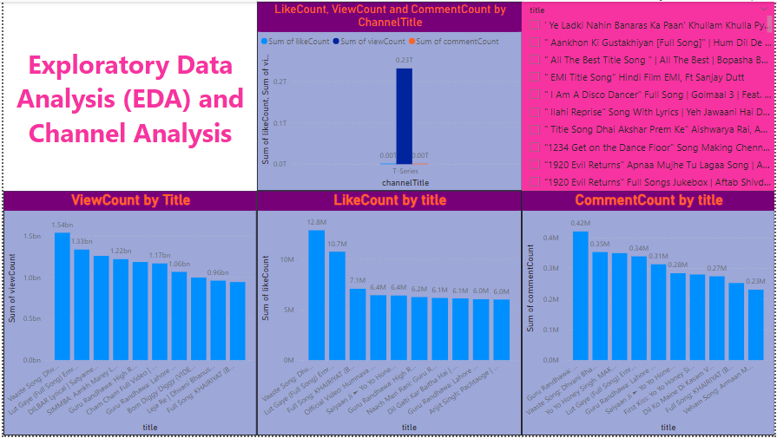
EDA & CHANNEL ANALYSIS

Slide 5
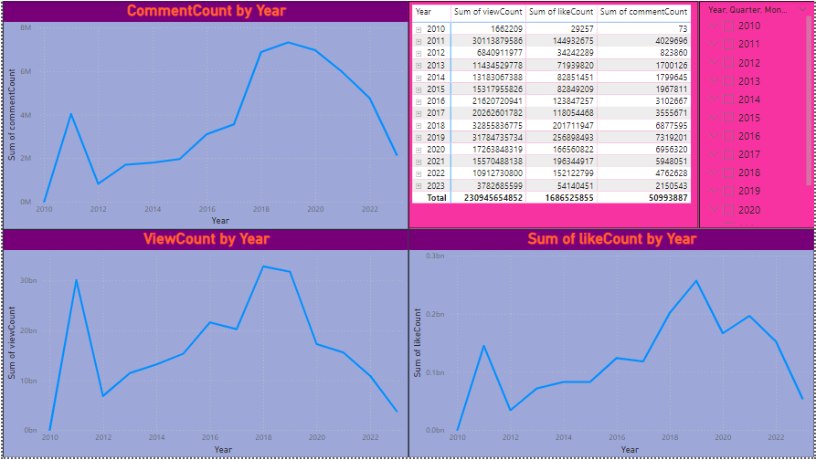
EDA & CHANNEL ANALYSIS CONT.

Slide 6
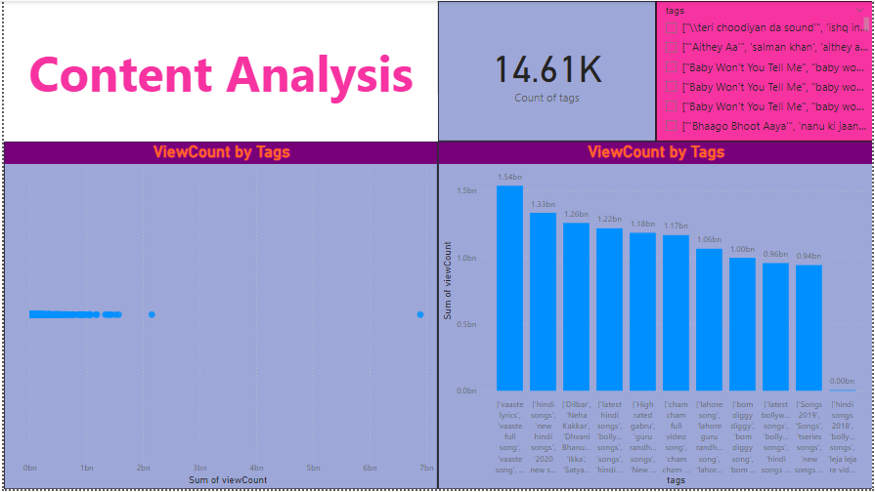
CONTENT ANALYSIS

Slide 7
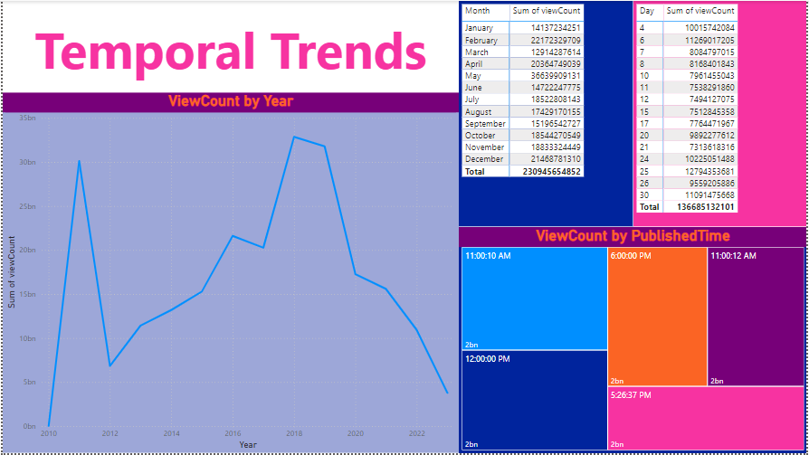
TEMPORAL ANALYSIS

Slide 8
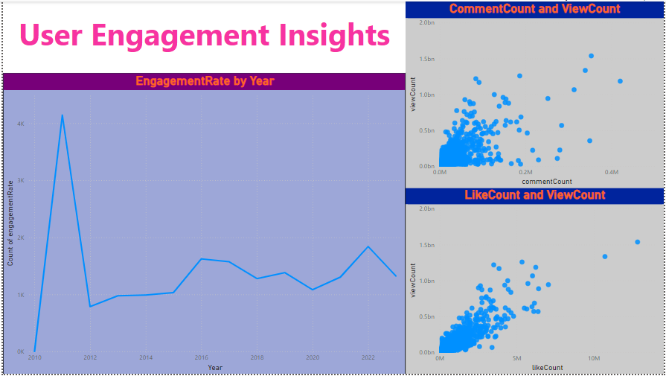
USER ENGAGEMENT INSIGHTS

Slide 9
RECOMMENDATIONS
Content Strategy:
Use trending and popular tags.
Analyze and replicate successful video characteristics.
Encourage audience engagement (questions, comment responses).
Publishing Strategy:
Publish during peak activity times.
Maintain a regular publishing schedule.
Plan content using a content calendar and align with seasons or events.

Slide 10
RECOMMENDATIONS
Content Optimization:
Optimize titles, descriptions, and tags for SEO.
Regularly review YouTube Analytics to adjust strategy.
Conduct A/B testing for titles, thumbnails, and tags.
Engagement Strategy:
Include clear calls to action (like, comment, share, subscribe).
Use interactive elements (YouTube cards, end screens, live chats).
Respond promptly to comments and pin interesting ones.
Organize videos into engaging playlists with auto-play enabled.

Slide 11

THANK YOU

